Slide 1


DIABETES 130-US HOSPITALS FOR YEARS 1999-2008
GROUP 4
PHANINDRA AAKASH SIDDANTH TEJASHWINI

Slide 2
INTRODUCTION
The study aims to improve patient safety by analyzing historical patterns in diabetes management among patients admitted to US hospitals, with the goal of conserving resources and money.
Clinical data databases pose challenges due to missing values, inconsistent or partial records, and high dimensionality.
The dataset includes both category and numeric columns, some of which are inconsistent or have missing values, and prescription drug information was also included to examine its potential impact on readmission rates.

Slide 3
PROBLEM DEFINITION
The study aims to improve patient safety by analyzing historical patterns in diabetes management among patients admitted to US hospitals, with the goal of conserving resources and money.
Clinical data databases pose challenges due to missing values, inconsistent or partial records, and high dimensionality.
The dataset includes both category and numeric columns, some of which are inconsistent or have missing values, and prescription drug information was also included to examine its potential impact on readmission rates.

Slide 4
DATA DESCRIPTION
The UCI Machine Learning Repository contains a diabetes dataset with data on hospital admissions of patients with diabetes from 1999 to 2008 in the US.
The aim is to build a logistic regression model to predict whether a patient will be readmitted within 30 days based on their medical history, medications, and demographic information.
The dataset includes 37 categorical and 13 numerical variables.
The data was filtered to select inpatient encounters (hospital admissions) that were related to diabetes and had a length of stay between 1 and 14 days. The encounters also had to include laboratory tests and medication administration.

Slide 5
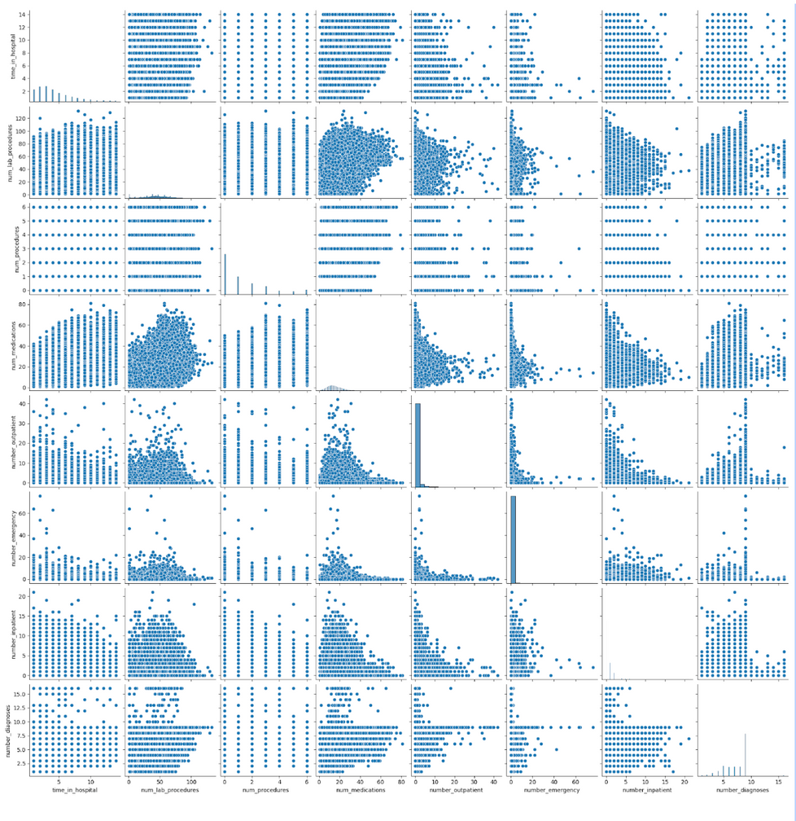
PAIRPLOT
It plots scatterplots for each pair of variables, histograms for each individual variable and also includes the correlation coefficient between each pair of variables.

Slide 6
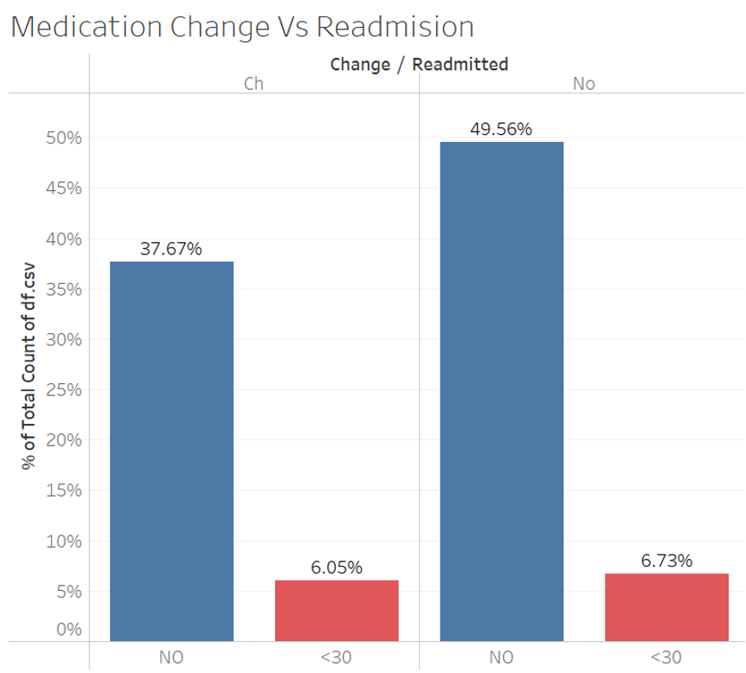
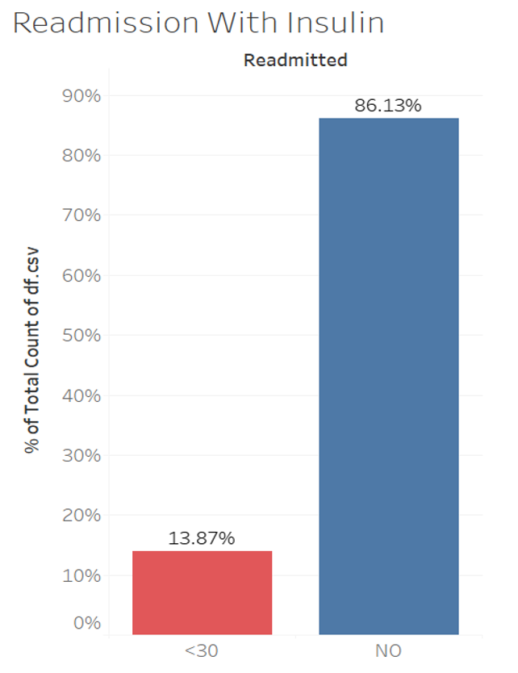
READMISSION STATISTICAL ANALYSIS

Slide 7
FEATURE ENGINEERING
Column ‘medical_speciality’ has 73 unique categories of values. Using one-hot encoding would create columns equal to number of different categories. To avoid this top-10 categories of the ‘medical_speciality’ has been considered which have almost 93% of data.
‘Age’ column in the dataset consists of bins. To make it easy for the model to train ‘Age’ values have been converted to numerical values. Example: [70-80) is converted to 75
Label column ‘readmitted’ has ‘30’, ‘NO’ values initially. Since our class of interest is ‘30’.
Features ‘ encounter_id’, ‘patient_nbr’ are removed as they represent unique row and do not contribute to model building.

Slide 8
LOGISTIC REGRESSION
The baseline model selected for this analysis is Logistic Regression, which is a type of algorithm used to predict the probability of a certain class.
Logistic Regression was chosen for this analysis because it is suitable for binary outcomes, linearly separable data, and independent data with no outliers.
The sigmoid function is used in Logistic Regression to provide binary output.

Slide 9
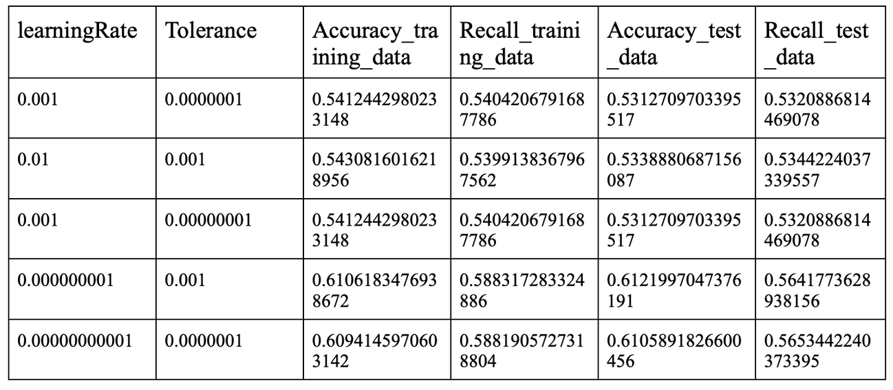
MODEL PERFORMANCE
Multiple combinations of hyperparameters were tried with the main focus on recall to reduce false negatives. Accuracy was also considered as a performance metric since the data was balanced. After trying different hyperparameters, a combination of learning rate and tolerance was selected which resulted in an accuracy of 62.2% and recall of 57.2%.

Slide 10
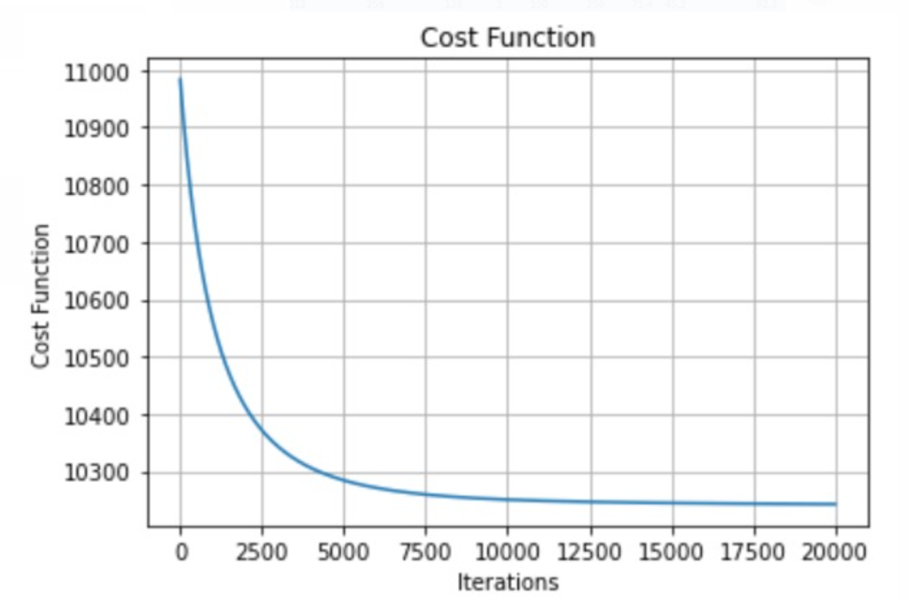
COST FUNCTION VS ITERATIONS

Slide 11

NEURAL NETWORK
In this project, a neural network was utilized to recognize patterns in data using an algorithm that simulates the workings of the human brain. The RELU activation function was used in the hidden layers because it is simple, fast, and has been observed to work well in practice. The Adam optimizer was employed, which combines the best aspects of AdaGrad and RMSProp, making it suitable for optimizing noisy data.

Slide 12
MODEL PERFORMANCE
Input | H1 | H2 | H3 | Output | epochs | batch | Accuracy | Recall
142 | 512 | 256 | 128 | 2 | 150 | 64 | 49.8 | 73
142 | 512 | 256 | 128 | 2 | 150 | 128 | 61.2 | 59
142 | 512 | 256 | 128 | 2 | 150 | 256 | 67.7 | 50.9
142 | 512 | 256 | 128 | 2 | 300 | 64 | 62.6 | 55.3
142 | 512 | 256 | 128 | 2 | 300 | 128 | 64.3 | 53.4
142 | 512 | 256 | 128 | 2 | 300 | 256 | 67 | 51.6
The performance of the neural network was improved by experimenting with different combinations of hyperparameters, including the number of neurons, epochs, and batch size. The best combination was found to have an accuracy of 65% and a recall of 58%, which was better than the logistic regression baseline model. The hyperparameters were adjusted to prioritize recall, resulting in a better performance for the scenario at hand.

Slide 13
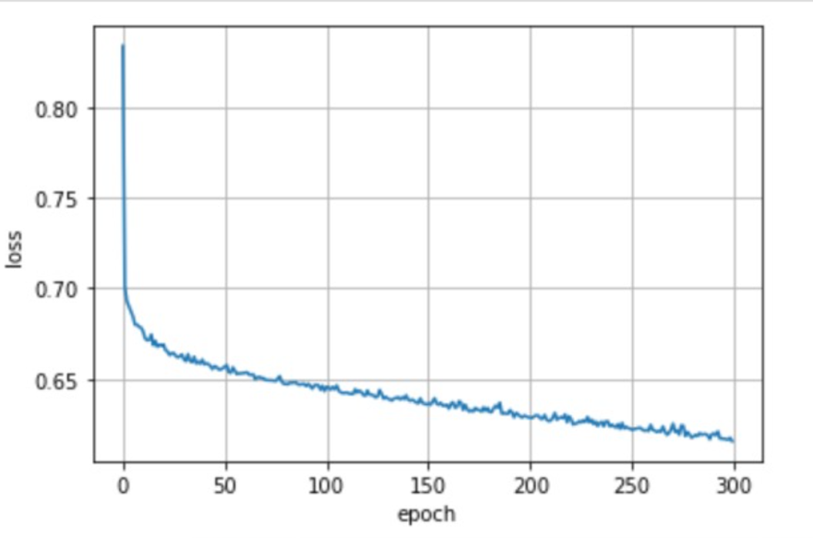
TRAINING LOSS VS EPOCHS

Slide 14
BIAS AND VARIANCE TRADEOFF
The validation set approach was employed in our model to avoid using the test data during model selection. This was achieved by training different models on 70% of the available data, and testing them on a separate 15% of data reserved as the validation set. The best-fit model was then selected based on its performance on the validation set, and its predictions were then evaluated on the remaining 15% of data set aside for testing.Logistic Regression was chosen for this analysis because it is suitable for binary outcomes, linearly separable data, and independent data with no outliers.
To prevent bias, we randomly shuffled the data before splitting it into training and testing sets. We also ensured that the training data had balanced class labels to avoid training the model on biased data, which could lead to generalization errors.
We adjusted different hyperparameters such as learning rate and tolerance for logistic regression, and the number of neurons, batch size, and epochs for neural network models to evaluate the data and improve the model's performance while minimizing errors. This process is called hyperparameter tuning.

Slide 15
REFERENCES
https://www.hindawi.com/journals/bmri/2014/781670/#B8
https://docs.google.com/spreadsheets/d/14oUegl5Bulxzy9z7i0RyI6wjOm4kUZyjxsJa7vF6diA/edit#gid=0
https://docs.google.com/spreadsheets/d/1MUAbyd26CdxM1UkhEJA6ggPH9Alcj1uyK5tBMKzdmIE/edit?usp=sharing
https://www.investopedia.com/terms/n/neuralnetwork.asp
https://stats.stackexchange.com/questions/126238/what-are-the-advantages-of-relu-over-sigmoid-function-in-deep-neural-networks
https://machinelearningmastery.com/adam-optimization-algorithm-for-deep-learning/

Slide 16


